Slide 2
Collaboration

Slide 3
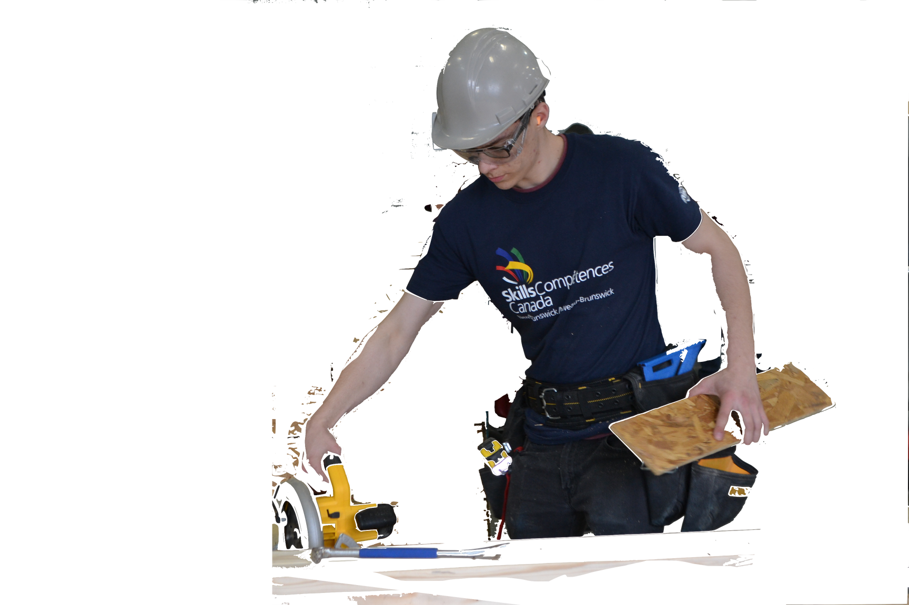
Agenda
Overview of the Skill Collaboration
Video
Activities

Slide 4
What is Collaboration?
Your ability to contribute and support others to achieve a common goal.
For example, in the workplace, we use this skill to provide meaningful support to team members while completing a project.

Slide 5
Why is this Skill Important?
Today people are more connected within communities, across the country, and around the world. Modern workplaces are more diverse, and many jobs require you to work with others from different backgrounds and cultures to complete tasks and solve problems.
It is important to be able to work respectfully with people who have different professions, experiences, cultures, and backgrounds.

Slide 6
Why is this Skill Important?
Collaboration skills help you perform better in a team by understanding how to support and value others, manage difficult interactions and contribute to the team’s work.
Strong collaboration skills help you build and maintain positive relationships with others at work, in school, and in other parts of your life.

Slide 7
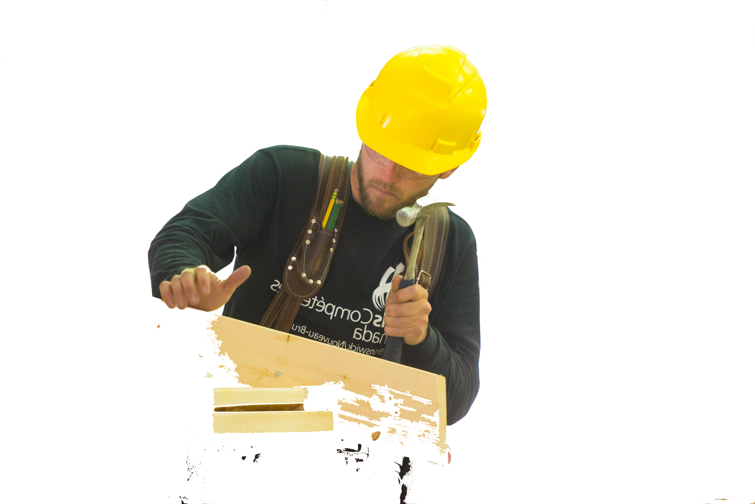
Video
https://www.youtube.com/watch?v=VS1_Kgpk-jw

Slide 8
Collaboration with Classmates/Teammates
Fitting into the culture at school or on a team, in a positive way, helps us to build trust with our peers and supports our participation on teams or when working with a partner.
It is also useful to think about what attitudes, behaviors and characteristics are commonly sought after by future employers, and what our values and attributes are, so we can determine if we are a match.
Please complete the Handout “Collaboration – Workplace Culture”

Slide 9
Activity: Workplace Culture
What notes did you make regarding why you made each of the choices you made?
Discuss with a partner and then we will discuss as a class.

Slide 10
Activity: The Back Up Team
No matter where you look, the Internet is changing the world. And while not all these changes are good, empowering the creativity of individuals and small teams is one of the great benefits the Internet offers.
Please complete the handout "Collaboration - The Back Up Team (2)"

Slide 11
Activity: Collaborating Positively Together
Review your handout and the descriptions given for collaborating with others in three different activities.
Choose one that you do and describe how you do that activity – working alone, with a partner, or on a team.

Slide 12
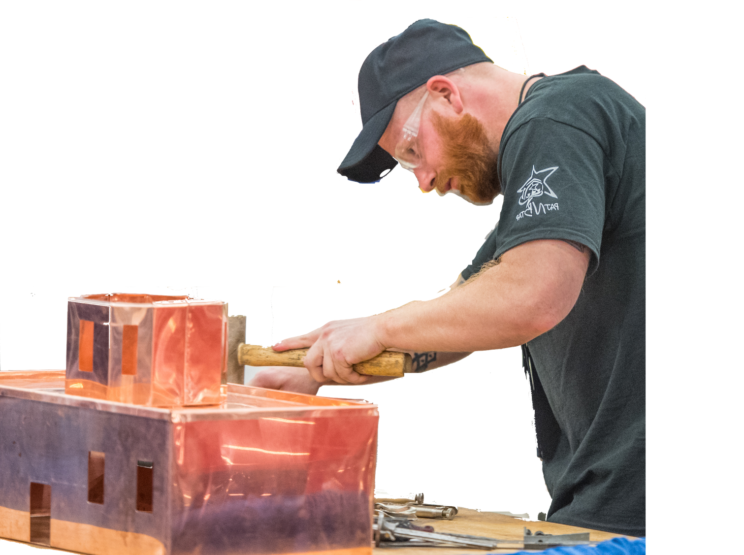
Occupation Research
Select one of the occupations from the list on your handout and research how workers in that job collaborates with others.
Provide at least one example of how they work.

